Slide 1


International Islamic University Malaysia
English Proficiency Test (EPT)

Slide 2

1. INTRODUCTION
2. EXEMPTION FROM EPT
3. EPT STRUCTURE
4. TEST CONTENT
5. PASSING REQUIREMENTS
6. SCORING
7. PLACEMENT
8. REMINDER
CONTENTS

Slide 3
INTRODUCTION
All students entering the International Islamic University Malaysia are given language tests in English and Arabic. The English Proficiency Test (EPT) is designed to place each student in the appropriate English class to suit his or her current level of English.

Slide 4
EXEMPTION FROM EPT
Exemption from EPT also can be given for students who have graduated from any educational institution such as schools, colleges and others of the following 5 English-speaking countries:
UK, Australia, New Zealand, Canada, USA. (Certificates from other than these 5 countries are not accepted).
* For exemption matters, please email your certificate to eptcelpad@iium.edu.my

Slide 5
EXEMPTION FROM EPT
Other accepted certificates are as follows:
  Cambridge Certificate of Proficiency in English (CPE): Minimum Grade C
  Cambridge Certificate of Advanced English (CAE): Minimum Grade B
  International Baccalaureate Standard Level (SL & HL): Score of 5 in English
  European Baccalaureate: Score of 70% in English
  IDEXCEL PTE - Scores of 50 and above
English Language IGCSE:
  English as First Language- Minimum Grade C & above
  English as Second Language – Minimum Grade B & above

Slide 6
IELTS, TOEFL (iBT) & MUET SCORES FOR EXEMPTION

Slide 7
EPT TEST STRUCTURE
TEST
DURATION
PAPER 1 (READING)
90 MINUTES
60 MINUTES
PAPER 2 (WRITING)

Slide 8
TEST CONTENT
Paper 1
Reading: 3 passages (40 questions)
Paper 2
Writing: 2 writing tasks

Slide 9

PASSING REQUIREMENTS

Slide 10
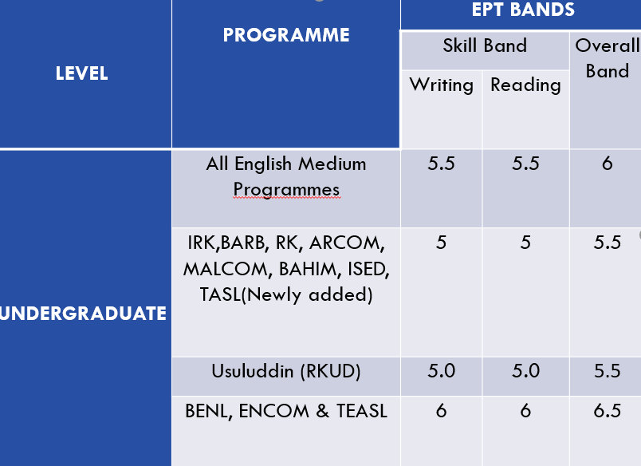
NEW CRITERIA FOR EXIT AND PLACEMENT (REVISED ADMISSION REQUIREMENT – EFFECTIVE SEMESTER 1, 2020/2021)
Minimum requirements for exemption (479th Senate Meeting):

Slide 11
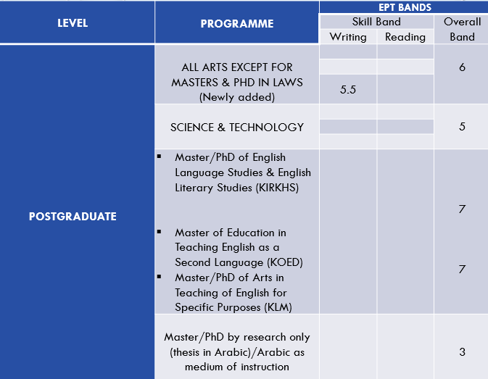

Slide 12

SCORING

Slide 13
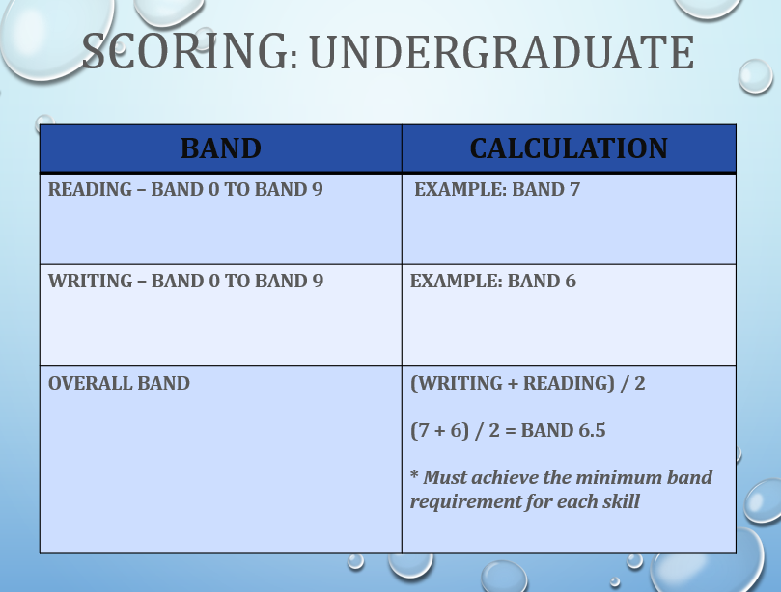
UNDERGRADUATE

Slide 14
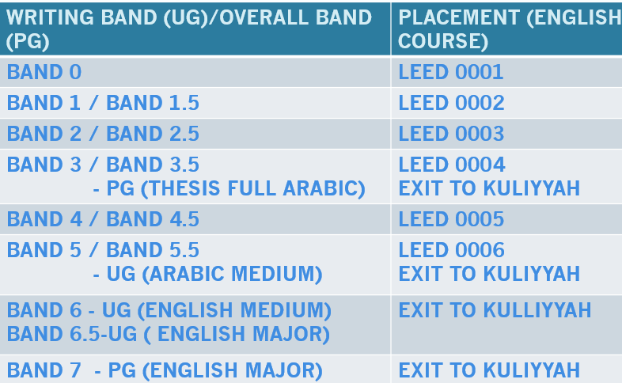
P
L
A
C
E
M
E
N
T

Slide 15
Documents TO BE PREPARED for the examination:
•Matric card/Temporary matric card
•Passport (or any other form of identification document with photo- I.D) + to verify your identity
PLEASE BRING YOUR I/C OR MATRIC CARD
A GENTLE REMINDER

Slide 16
THE FOLLOWING ARE NOT APPLICABLE FOR NEW INTAKE EPT:
  RECHECKING OF RESULT
  RESIT

Slide 17
THANK YOU
ALL THE BEST!

