Slide 1
CROSSING CULTURAL BOUNDARIES: ISLAM IN S.E.ASIA AND AUSTRALIA*
M. KAMAL HASSAN
I.I.U.M
*
Keynote address presented at Australia-Malaysia Youth Leadership & Cross Cultural Dialogue Conference, organised by ICEO and Forum on Australia’s Islamic Relations at IIUM on 16 June 2010
I.I.U.M.
16 JUNE 2010

Slide 2
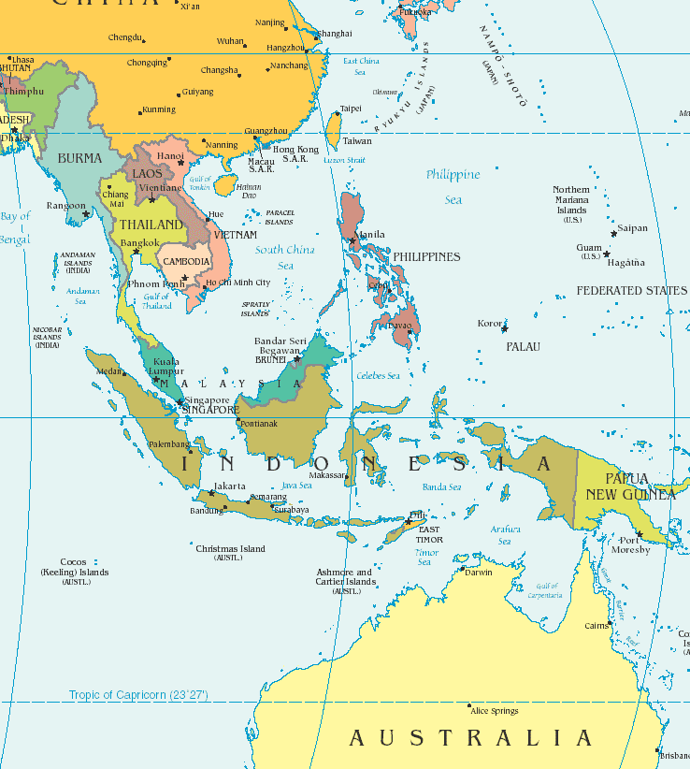
MAP OF S.E.ASIA & AUSTRALIA

Slide 3
S.E.ASIA BEFORE THE ADVENT OF ISLAM
Hindu influence in the Khmer Empire in Cambodia, Southern Vietnam, and in Sumatra and Java.
Buddhist influence in three regions: Malaysia and Indonesia region, with Buddhist Kingdom of Srivijaya in Sumatra; mainland S.E.Asia (Burma and Thailand) and Vietnam. Hinayana dominance was replaced by Mahayana, with Borubudor stupa as the greatest monument. Bali remains under Hindu influence

Slide 4
THE ADVENT OF ISLAM IN INDONESIA, MALAYSIA, PHILLIPINES (10-15 C.E.)
ISLAM CAME IN STAGES: TRAVEL, TRADE, SETTLEMENT, KINGDOMS.
AS EXPLAINED BY Sir THOMAS ARNOLD (The Preaching of Islam: A History of the Propagation of the Muslim Faith, London: Constable and Co. Ltd, 1913) islam was spread peacefully;
“Causes that contributed to their success: the simplicity of the Muslim creed: the rationalism and ritualism of Islam. Islam not spread by the sword. The toleration of Muhammadan governments.”
The role of traders, preachers and rulers in transforming the pre-Islamic culture—from polytheism, animism, magic and tribalism to absolute monotheism, rationalism and universal brotherhood.
Acheh, Malacca, Patani as centres of Islamic governance, culture and learning.

Slide 5
TRANSFORMATION OF MALAY-INDONESIAN CULTURE (10 – 15 C.E.)
COSMOLOGY
ONTOLOGY
THEOLOGY
EPISTEMOLOGY
LAW
ETHICS
POLITICS

Slide 6
IMPACT OF WESTERN INTRUSION AND IMPERIALISM
FROM TOLERANCE TO WAR: ACHEH, INDONESIA, MALAY STATES, MUSLIM MINDANAO
IMPOSITION OF WESTERN POWER, INSTITUTIONS AND SECULARISM
ISLAM MARGINALISED
NATIONALISM EMERGED
ISLAM AND NATIONALISM VS. WESTERN DOMINANCE

Slide 7
THE STRUGGLE FOR INDEPENDENCE , SEPARATION AND LIBERATION
INDONESIA FROM DUTCH CONTROL
MALAYSIA FROM BRITISH CONTROL
MOROLAND FROM SPANISH AND AMERICAN CONTROL
PATANI FROM THAI CONTROL
BRUNEI FROM BRITISH CONTROL
COMMUNISM AS ANTI-COLONIAL FORCE
JAPANESE INTERREGNUM (1942-1945)

Slide 8
POST-INDEPENDENCE ISLAMIC THOUGHT IN S.E.A.
REFORMISM AS MODERNISING AND LIBERATING FORCE
ISLAMIC MOVEMENT AS ANTI-SECULAR AND ANTI-WESTERNISATION
DEMOCRACY ADOPTED BY NATIONALISM AND ISLAMIC REFORMISM
PATANI AND MOROLAND STRUGGLING FOR SEPARATISM AND LIBERATION

Slide 9
MUSLIM MAJORITY WITH DEMOCRACY, MUSLIM MINORITY WITH OPPRESSION
INDONESIAN ISLAM UNDER SOEKARNO AND SOEHARTO – SECULARISATION AND NATIONALISATION OF ISLAM, RISE OF DAKWAH MVT
ISLAMIC POLITICAL PARTY ADVANCES WITH DEMOCRACY IN MALAYSIA, EMBRACES PLURALISM
PATANI MUSLIM COMMUNITY IN DILEMMA AND MOROS IN PHILLIPINES UNDER PRESSURE FROM CHRISTIAN DOMINATED GOVERNMENT
CHAMPA MUSLIMS FACED GENOCIDE UNDER POL POT
ROHINGYA MUSLIMS OF BURMA UNDER OPPRESSION

Slide 10
POST 9/11 SCENARIO
SPECTRE OF NEO-CRUSADES UNDER BUSH
ISLAM AND MUSLIMS “THE NEW ENEMY”
WESTERN DEMOCRACY, CAPITALISM AND LIBERALISM AS “THE NEW GOSPEL”
PEACE IN MIDDLE EAST ON ISRAELI TERMS
MUSLIM MILITANCY HEIGHTENED AND TARGETED
CHRISTIAN FUNDAMENTALISM AND NE0-CONS PUSHING PROSELYTISATION IN MUSLIM COUNTRIES
GLOBALISATION TRIES TO FLATTEN THE WORLD (Thomas Friedman, The World is Flat, 2005)
ISLAMOPHOBIA IN THE WEST AND IN THE MEDIA

Slide 11
Australia and Muslims Towards a Greener Future
“The Second World War and the economic boom which came in its wake,… mark a watershed in the history of Muslims in Australia. …World opinion began to change. Notions of racial superiority became unacceptable. Newly independent post-colonial states were wary of dealings with nations adhering to racist policies. Within Australia voices for change became stronger each year until the content, if not the form, of the White Australia Policy had to go. It has only been since the change in national policy from the late 1960s that a Muslim community has been able to develop once again. Without changes in community attitudes in the past few decades, such changes would not have been sustainable.”
(source: www. islamfortoday/com/aust.,accessed 14/6/10)

Slide 12
THE MUSLIM RESPONSES IN S.E.A.
MILITANCY OF SOME MUSLIM EXTREMISTS
THE MUSLIM MAJORITY PREFER DEMOCRATIC ACTIONS, DIALOGUE AND NON-VIOLENT DEMONSTRATION.
MUSLIM SCHOLARS OPPOSED TO VIOLENCE, TERRORISM, ZIONIST PROPAGANDA AND AGGRESSIVE CHRISTIAN EVANGELISATION IN MINDANAO, INDONESIA, MALAYSIA, SINGAPORE.
ISLAMIC INSTITUTIONS AND NGO’S EMPHASISE THE PROMOTION OF BETTER UNDERSTANDING OF ISLAM AS RELIGION, CULTURE, STATE AND CIVILISATION-- “MODERATE MUSLIMS” IN Indonesia, “Islam Hadhari” in Malaysia, “Islamic Moderation” in Singapore

Slide 13
AUSTRALIA AND ISLAM: A DELICATE RELATIONSHIP
“The Second World War and the economic boom which came in its wake, mark a watershed in the history of Muslims in Australia…. World opinion began to change. Notions of racial superiority became unacceptable. Newly independent post-colonial states were wary of dealings with nations adhering to racist policies. Within Australia voices for change became stronger each year until the content, if not the form, of the White Australia Policy had to go. It has only been since the change in national policy from the late 1960s that a Muslim community has been able to develop once again. Without changes in community attitudes in the past few decades, such changes would not have been sustainable.”
(source: www.islamfortoday.com/aust) acc. 14/6/10

Slide 14
AUSTRALIA AND ISLAM: TOWARDS A GREENER FUTURE
1.Islam and Muslims are part of religious diversity in a democratic nation. Acceptance of presence of Muslims just as Muslims have to accept the reality of secular majority state.
2.Problems have to be solved within the given laws and constitution of the country. Mainstream Muslims have to curb any extremist tendency of Muslim individuals or groups.

Slide 15
Contd.
Muslims have to abandon the ethnic cultural baggage to participate fully in a democratic society where English is the dominant and official language and secular cultural norms are the mainstream.
Australians should be better informed informed about the moral, spiritual, family and social values of Islam in S.E.Asian countries to get rid of the psychology or paranoia of fear, suspicion and distrust.

Slide 16
Contd.
The ongoing crisis in the Middle East and the Israeli-Palestine conflict should be studied, analysed and understood objectively in light of the historical context after the 1st World War and the 2nd World War, the rise of Zionism and the biased attitudes and actions of the Western super powers then and now.
Be assured that democracy and Islam and cultural diversity are compatible as shown by Malaysia, Indonesia and Turkey.
The West is beginning to realise that Islamic financial and banking institutions do have their merits and could point the way to a more just, moral and humane economic system

Slide 17
Fundamental Principles in Muslim-Nonmuslim Relationship
“(Allah does not forbid you respecting those who have not made war against you on account of (your) religion, and have not driven you forth from your homes, that you show them kindness and deal with them justly; surely Allah loves the doers of justice. Allah only forbids you respecting those who made war upon you on account of (your) religion, and drove you forth from your homes and backed up (others) in your expulsion, that you make friends (and ally) with them, and whoever makes friends with them, these are wrong-doers.) (Al-Mumtahanah 60:8-9)

Slide 18
REMOVE THE MAJOR OBSTACLES TO HARMONIOUS COEXISTENCE
RELIGIOUS EXTREMISM and FANATICAL EVANGELISATION
SECULAR FUNDAMENTALISM, MILITANT ATHEISM, HEGEMONISTIC WORLD POWER, MONOPOLISTIC GREED OF MNC’S, HEDONISTIC CULTURAL NEO-IMPERIALISM
RACIALISTIC AND XENOPOHIBIC NATIONAL OR REGIONAL POLITICS
4. BIASED MEDIA AIMED AT MISINFORMATION, DEMONISATION OF ISLAM AND MUSLIMS, AND DECEPTION ON WORLD-WIDE SCALE

Slide 19
WE FACE A COMMON FUTURE
OUR PLANET THREATENED BY
1. ENVIRONMENTAL CATASTROPHIES
2. FOOD AND WATER SCARCITIES
3. COLLAPSE OF MORALITY IN POLITICS AND ECONOMY
4. CRISIS OF KNOWLEDGE & MODERN SCIENCE
5. FAILURE OF SECULAR MODERNITY

Slide 20
LEST WE FORGET THE TEACHINGS OF THE QUR’AN
MUSLIMS AND NON-MUSLIMS ARE BROTHERS AND SISTERS IN BEING CREATURES OF THE SAME GOD
GOD CREATED US ALL – BLACKS, WHITES, BROWNS, YELLOWS AS EQUALS, THE MOST HONOURABLE OF US ARE THE MOST GOD-FEARING
THE EARTH, THE WEST, THE EAST AND ALL NATURAL RESOURCES BELONG TO GOD
ALL HUMAN BEINGS ARE VICEGERENTS OF GOD
SATAN AND BASE DESIRES ARE THE COMMON ENEMIES. THEY INCITE HATE AND DISSENSION
GOOD CHARACTER AND COMPASSIONATE HUMAN RELATIONS ARE THE GOALS OF PROPHETIC MISSION
WE, MUSLIMS AND NON-MUSLIMS IN S.E.A. & AUSTRALIA, MUST AND CAN LIVE IN PEACE WITH MUTUAL RESPECT AND COOPERATION IN ALL MATTERS OF COMMON INTEREST

