Slide 1

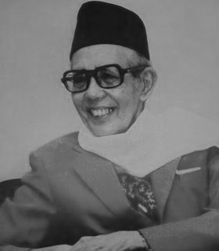
M. NATSIR(1908 -1993): HIS LIFE & THOUGHT
M. Kamal Hassan,
ISTAC, IIUM

Slide 2

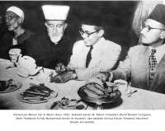
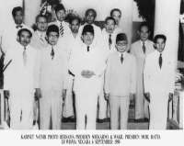

Slide 3
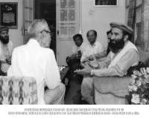


Slide 4
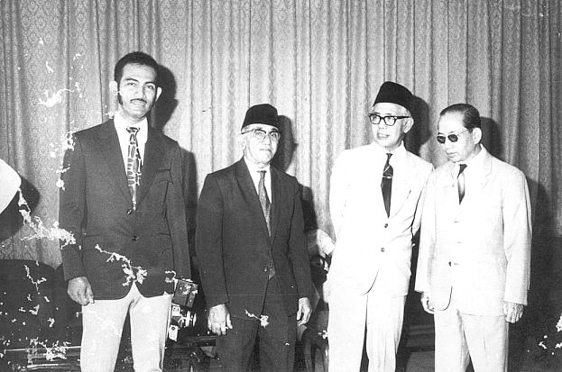
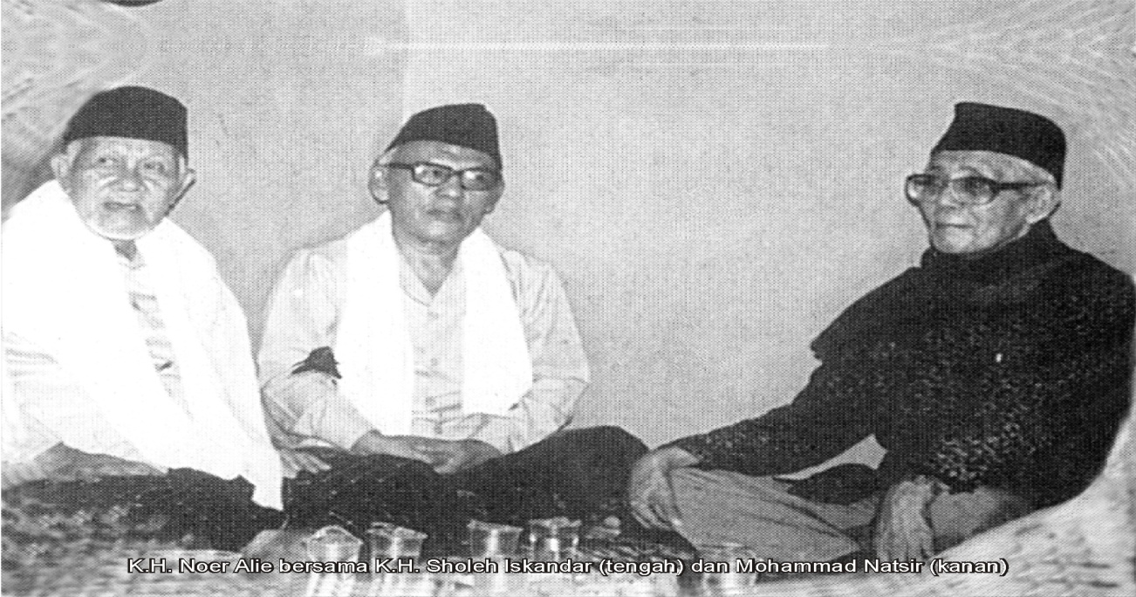

Slide 5
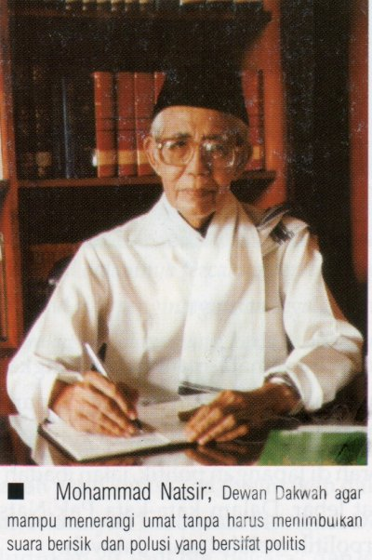
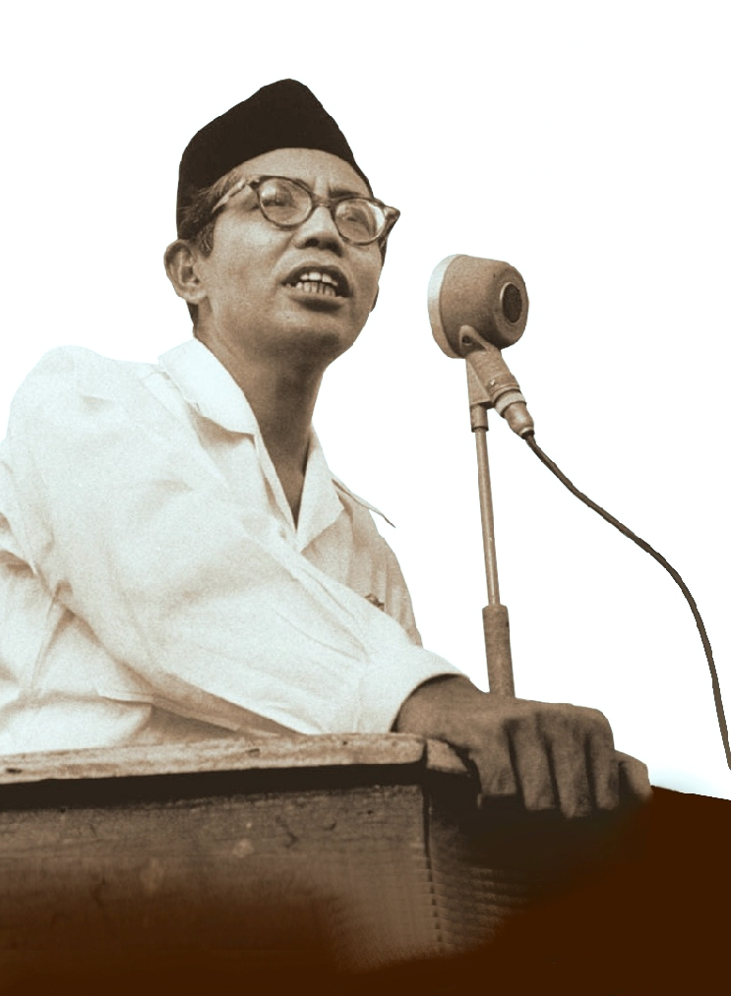

Slide 6

Brief Biography of M. Natsir According to Wikipedia
Mohammad Natsir (17 July 1908 – 6 February 1993) was a Islamic scholar and politician. He was Indonesia's fifth prime minister.
After moving to Bandung from his hometown Solok, West Sumatra for senior high school, Natsir studied Islamic doctrine extensively. His first articles were published in 1929, and during the 1930s he wrote for several Islamic-themed papers. He entered politics in the mid-1930s, rising through the ranks of Islamic parties. On 5 September 1950, he was chosen as prime minister, a term which he served until 26 April 1951. After his term as prime minister, he became increasingly vocal about Islam's role in Indonesia and was eventually arrested for doing so. Released in 1966 after the New Order government took power, Natsir continued to be critical of the government, eventually leading to him being banned from traveling.

Slide 7
Natsir wrote extensively on Islam, totaling 45 books and hundreds of articles. He viewed Islam as an intrinsic part of Indonesian culture and was disappointed by the Sukarno and Suharto governments' handling of the religion. He was given three honourary doctorates during his lifetime, one from Lebanon and two from Malaysia. On 10 November 2008, Natsir was honoured as a national hero of Indonesia.

Slide 8
Early life
Natsir was born in Solok, West Sumatra on 17 July 1908. His parents were Mohammad Idris Sutan Saripado, a government employee, and Khadijah. In 1916, he studied at HIS (Hollandsch-Inlandsche School) Adabiyah, Padang. After a few months, he moved to HIS Solok, studying there by day and at the Madrasah Diniyah by night. Three years later, he moved to HIS Padang together with his older sister. In 1923, he continued his studies at MULO (Meer Uitgebreid Lager Onderwijs) and he joined Pandu Nationale Islamietische Pavinderij and Jong Islamieten Bond. He also learned to play violin.
After graduating he moved to Bandung, where he studied at an AMS (Algememe Midelbare School, or senior high school). Natsir later said that he had chosen the school for its Western classics class. From 1928 until 1932, he became a chairman of JIB Bandung. He then received a teaching permit after studying for two years at a native teacher's training college. Although he had previously studied Islam in West Sumatra, while in Bandung he took a deeper interest in the religion, including subjects such as the interpretation of the Quran, Islamic jurisprudence, and dialectics; he later studied under Ahmad Hassan, the leader of Persatuan Islam.

Slide 9
Career
While still in high school, Natsir became involved in journalism. In 1929 he wrote two articles published in the Algemeen Indische Dagblad, entitled "Qur'an en Evangelie" ("The Quran and the Evangelicals") and "Muhammad als Profeet" ("Muhammad as the Prophet"). He also collaborated with other thinkers to publish the newspaper Pembela Islam (Defenders of Islam) from 1929 to 1935, and wrote extensively about his views on the religion for Pandji Islam (Banner of Islam), Pedoman Masyarakat (Guide for the People), and Al-Manār (The Torch). Aside from writing, Natsir founded Pendidikan Islam (Islamic Education), a private school, in 1930; the school was shut down after the Japanese occupation of Indonesia.

Slide 10
Natsir began to associate with well-known scholars of Islam like Agus Salim, and in the mid 1930s he took Salim's place in discussing the relationship between Islam and the state with future-president Sukarno. In 1938, he enrolled as a member of Partai Islam Indonesia (The Indonesian Islamic Party), and became the chairman of the Bandung branch from 1940 until 1942. He was also employed as the Bandung Bureau Head of Education until 1945. During the Japanese occupation, he joined Majelis Islam A'la Indonesia (changed to Majelis Syura Muslimim Indonesia later), and became one of its chairmen from 1945 until the party was banned.
After the Proclamation of Indonesian Independence, he became a Central Indonesian National Committee member. On 3 April 1950, he proposed a motion called Mosi Integral Natsir, that united Indonesia after an agreement which divided Indonesia to seventeen states. Soon afterwards, he became prime minister, influenced by his role as the head of Masyumi. He served until 1951

Slide 11
In the Guided Democracy era, he opposed the government and joined the Revolutionary Government of the Republic of Indonesia. As a result, he was arrested and imprisoned in Malang from 1962 until 1964. He was released by the New Order government in July 1966.
After his release from prison, Natsir became increasingly involved with organizations related to Islam, including the Majlis Ta'sisi Rabitah Alam Islami and Majlis Ala al-Alami lil Masjid, both in Mecca, the Oxford Centre for Islamic Studies in England, and the World Muslim Congress in Karachi, Pakistan.

Slide 12
In New Order era, he formed Yayasan Dewan Dakwah Islamiyah Indonesia. He also criticized government policy, like when he signed the Petisi 50 on 5 May 1980, which caused him to be banned from going overseas.He died on 6 February 1993 in Jakarta.

Slide 13
Politics and views
According to Natsir, his politics were religiously motivated, with ayat 56 of the Adh-Dhariyat as justification. His goal as a politician was to ensure that the Muslim community lived in a state where Islamic teachings "applied in the life of individual, society, and the state of the Republic of Indonesia". He also fought for human rights and the modernization of Islam.
Unlike the Kemalist Sukarno, who viewed religion as an entity separated from the nation, Natsir believed that the separation of church and state was not applicable to Indonesia, as he saw it was an intrinsic part of their culture and one of the main reasons they fought for independence. To support his position, he often quoted William Montgomery Watt, saying that Islam is not just a religion, but an entire culture. After independence, Natsir became increasingly disheartened by how Sukarno, and later Suharto, dealt with religion, writing in the early 1970s that Indonesia was treating Islam as one would treat "a cat with ring-worms". He later began trying to bring Pancasila, the state philosophy of Indonesia, completely in accordance with Islam.

Slide 14
Writings
Natsir published 45 books or monographs and several hundred articles dealing with his views of Islam. His early works, published in Dutch and Indonesian, dealt with Islamic doctrine, culture, the relationship between Islam and politics, and the role of women in Islam. His later works included some written in English and focused more on politics, as well as the preaching of Islam and Christian-Muslim relations. Ajip Rosidi and Haji Abdul Malik Karim Amrullah have noted that Natsir's writings serve both as historical records and also as guides for future Muslims.

Slide 15
Legacy
In 1980, he received award from King Faisal Foundation. In academic, he received doctorate honorary degree from Islamic University of Lebanon in 1967 for literature. In 1991, he also received an honourary doctorate from Universiti Kebangsaan Malaysia and Universiti Sains Malaysia for Islamic ideas. On 10 November 2008 he was honoured as a national hero of Indonesia.
According to Bruce Lawrence, Natsir was "the most prominent politician favoring Islamic reform."

Slide 16
Personal life
He married Nurnahar in Bandung on 20 October 1934. From their marriage, they had six children. Natsir could reportedly speak numerous languages, including English, Dutch, French, German, and Arabic; he was also capable of understanding Esperanto.
Source: Wikipedia.org (13 March 2012)

Slide 17
THE INTELLECTUALITY OF M. NATSIR: A MUCH-NEEDED MODEL FOR THIS ERA OF CORRUPTION & TURBULENCE
“Last of the giants among Indonesia’s nationalist and revolutionary political leaders, he [Mohammad Natsir] undoubtedly had more influence on the course of Islamic thought and politics in postwar Indonesia than any of his contemporaries. By nature extraordinarily modest and unpretentious, he had a well deserved reputation for personal integrity and political probity. He always lived simply with respect to house and attire, even in 1950 as prime minister. (When I first met him in 1948 and he was the Republic’s minister of information, I found a man in what was surely the most mended shirt of any official in Yogyakarta; it was his only shirt….)”.
George McT.Kahin, Indonesia, vol.56 (Oct.1993);159-165.

Slide 18
A Rare Breed of Muslim National Leader:
“Political probity”
“Personal integrity”
“Extraordinarily modest and unpretentious”
“A leader who has no peer up to the present time”

Slide 19
National Hero
“National Hero”, who traversed for political eras – Dutch colonialism, revolution period, Old Order of President Sukarno & the New Older of President Suharto

Slide 20
The True Tajdid vs The False Tajdid
“Berdakwah di jalur politik” dan “Berpolitik di jalur dakwah”.
“Neo-modernisme” rintisan Nurcholish Madjid, Abdurrahman Wahid (“Gus Dur”) dan “liberalisme” Ulil Abshar-Abdalla dan rakan-rakannya.
“diabolisme intelektual” (Adian Husaini, 2005) atau “diabolisme pemikiran”.

Slide 21
“Pembaharuan” oleh gerakan “neo-Modernis”
“Mereka berdiri dipinggir tebing yang sangat curam,” menurut ahli sejarah Dr. Taufik Abdullah (Greg Barton, 1995: 297)
“Bila terjadi pembaharuan yang kita lakukan itu sampai terlepas dari Islam, jelas kita berbuat khianat”. (Greg Barton, 1995:298)

Slide 22
Intellectuality Built Upon a Sound `Aqidah & Correct Understanding of Islam
Berpegang teguh secara konsisten kepada doktrin-doktrin dan ajaran-ajaran agama Islam yang diwarisi daripada generasi al-salaf al-salih secara turun temurun sebagai perkara-perkara pokok (al-thawabit) yang tidak tertakluk kepada perubahan zaman (al-mutghayyirat).

Slide 23
….maka Islam adalah satu sintese jang tjukup memberi keluasan untuk perdjalanan evolusi dalam hal-hal jang memang mesti ber-evolusi dan bersipat radikal dalam bidang-bidang jang mesti radikal, akan tetapi dalam pada itu ia mempunyai pula beberapa anasir-anasir, beberapa rukun-rukun jang bersipat ke Tuhanan jang kekal dan tak berubah-ubah, untuk djadi sauh atau djangkar, jang akan memperlindunginya dari pada hanjut terapung-apung, kesana-sini, dibawa oleh alun dan aliran zaman.

Slide 24
Adapun prinsip dan kaedah sudah tetap, tidak boleh dibongkar-bongkar lagi, tidak mesti diserahkan pula lebih dulu kepada hasil undian menurut sistem ‘separo-tambah-satu-suara’.” (M.Natsir, Capita Selecta:452).

Slide 25
M. Natsir as a Leader of the Ummah
Natsir sebagai seorang pemimpin sejati dan – menurut Mohamad Roem – “hati nurani ummat” (Amien Rais, 1988:79), pejuang kebangsaan, patriot, politisi, diplomat, negarawan, pendidik, guru, penulis, pemikiran dan da‘i. Kajian menunjukkan bahawa pribadi mu’min, mukhlis dan muttaqi telah menyatukan kepelbagaian fungsi dan perwatakan Mohammad Natsir dalam satu kesatuan yang harmonis, indah dan menarik (Anwar Harjono dkk., 2001; Endang Saifuddin Ansari dan Amien Rais, 1988).

Slide 26
“Sosok artikulatif yang selalu memelihara kehalusan tutur katanya dalam berpolitik,” (http://www.freelists.org/post/nasional-list/politik-SantunMohammadNatsir-Re-ppii, 26/11/2008).
“Saat menerjuni bidang politik, Muhammad Natsir adalah seorang politikus piawai. Saat menerjuni medan perang, ia menjadi panglima yang gagah berani, dan saat berdebat dengan musuh, ia tampil sebagai pakar ilmu dan dakwah.” (“Muhammad Natsir, Mujahid dan Politikus Piawai”,
http://www.pbb-info.com.26/11/2008).

Slide 27
Tidak boleh luput dari dada tiap-tiap pimpinan Islam: ketabahan jang tak mundur madju, kekontanannja jang tak boleh ditawar, kerendahan hatinja jang tuhan udji, dan keichlasannja jang berani djamin!

Slide 28
Dengan penguasaan bahasa Belanda, Jerman, Inggeris, Perancis dan Latin, beliau yang tidak pernah merasa jemu belajar, memperkaya mindanya dengan khazanah pemikiran Barat moden dan klasik tanpa terpengaruh dengan aliran pemikiran atau filsafat tamaddun humanisme sekular atau atheistik. Beliau mendapat inspirasi daripada sarjana-sarjana agung Islam termasuk Muhammad ‘Abduh dan Muhammad Iqbal serta cendekiawan-cendekiawan besar dan berpengaruh di Indonesia saperti Haji Agus Salim, Ahmad Soorkati dan A. Hasan.

Slide 29
Pegangan yang kuat kepada al-Qur’an al-Karim dan Sunnah Rasul (s.a.w) diteruskan melalui pengajian kitab-kitab tafsir saperti Tafsir Ibn Kathir, Fi Zilal al-Qur’an dan Tafsir al-Furqan peninggalan guru beliau A. Hasan (Adian Husaini. http://adianhusaini. Blogspot.com).

Slide 30
Snouck Hurgronje: “Pendidikan dan pelajaran dapat melepaskan orang Muslimin dari genggaman Islam.” Beliau amat memahami maksud kata-kata Snouck Hurgronje,: “La solution de la question islamique dépend de l’adhésion des indigènes a notre civilisation.” (Capita Selecta, 190).

Slide 31
Formation of `Ulama’-Intellectual & Intellectual-’Ulama’
Beliau ingin melihat penyatuan dua golongan inteligensia umat Islam, ulamak dan intelektual, sehingga wujud ulamak-intelektual dan intelektual-ulamak (Capita Selecta, 95-103). Pendidikan dalam wacana M.Natsir ialah satu proses pembangunan holistik jasmani-ruhani “jang menudju kepada kesempurnaan dan lengkapnya sifat-sifat kemanusiaan dengan arti yang sesunguhnya.” (Capita Selecta, 82). Beliau menjelaskan bahawa tujuan pendidikan Islam yang bersepadu tidak lain dari proses merealisasi tujuan hidup ber-‘ubudiyyah kepada Allah (S.W.T). Hamba Allah yang berilmu itulah yang benar-benar takut kepada Tuhannya (Q.Al-Fatir: 28).

Slide 32
Bapak M. Natsir pada tahun 1938 lagi sudah menyuarakan peri pentingnya diwujudkan Sekolah Tinggi Islam atau “Universitet Islam” di Indonesia (Capita Selecta, 102-103.) dan terciptanya satu “Perikatan Perguruan-perguruan Muslimin Indonesia” dengan nama singkatan “Permusi”. (Capita Selecta, 113).

Slide 33
The Concept of Reason/Intellect From Islamic Perspective
Aliran pemikiran “neo-Mu’tazilah”, “neo-Modernis”, Jaringan Islam Liberal dan para sekularis yang wujud di Indonesia hari ini, pada dasarnya menggunakan pertimbangan akal merdeka sebagai neraca tertinggi dalam menetukan kebenaran ajaran-ajaran agama.

Slide 34
Pentingnya akal dan kemerdekaan berfikir dalam ajaran Islam. Namun “akal merdeka yang lepas dari patokan agama”, “akal merdeka yang salah pasang”, “akal merdeka yang tersesat” dan “yang tidak berdisiplin” membawa banyak penyelewengan dalam kefahaman agama seperti “i‘tikad anthropomorphisme”, “i‘tikad pantheisme”, “taqlid-buta”, mengadakan “khurafat modern”.

Slide 35
Akal merdeka bisa membersihkan Agama kita dari kutu-kutu yang berbahaya untuk kemajuan, atau bertentangan dengan Agama kita sendiri. Pandai membukakan jendela lapangan pikiran kita supaya bertukar udara yang bersih dan nyaman. Dalam pada itu ia pandai pula membongkar tiang-tiang Agama kita, membongkar hudud Agama kita. Bukan saja memasukkan udara yang sepoi-sepoi basah, akan tetapi juga memasukkan angin taufan limbubu, manghancurkan apa yang ada. Semua dengan alasan: mencari sintese, manyesuaikan dengan kemajuan ‘zaman’ yang modern…. Akal merdeka bisa membenarkan perzinaan sebagai salah satu hak-hak asasi!
(M.Natsir, 1988:14-15)

Slide 36
“Akal anarki yang tak kenal batas” pada tahun 1940 masih relevan dengan isu hangat masa kini. Antara lain beliau mengatakan, “Dan kesudahannya yang kita peroleh dari akal merdeka itu, bukan lagi interpretasie Agama, melainkan likuidasie Agama!” (M. Natsir, 1988:42).

Slide 37
“Akal merdeka 100% tidak menggariskan batas buat dirinya. Semua ia mau labrak, semua ia mau atur, semua mau ia kritik. Kecuali mengeritik dirinya sendiri!” (M. Natsir, 1988: 42).

Slide 38
The Danger of Religious Pluralism
Ada dokter yang datang dengan obat ‘synthese’, ya’ni obat campur-aduk sebagaimana yang dianjurkan oleh orang-orang theosofie, yang berpendapat bahawa semua agama itu sama-sama baik, dan lantaran itu kita ambil dari Islam mana yang baik. Diambil dari Kristen, dari Hindu, mana yang kita ‘rasa baik’… yang akhir kesudahannya menghasilkan suatu ‘agama gado-gado’... Sekali lagi! Boleh jadi maksudnya bermula hendak me-interpretasikan Agama. Akan tetapi akibat yang dihasilkannya ialah likwidasi Agama! (M. Natsir, 1988: 46-49).

Slide 39
Beliau menerangkan kenapa pendirian “l’art pour l’art” (seni untuk kesenian) tidak boleh diterima. Memang diakui bahawa “Sesungguhnya Allah itu Jamiil, dan Ia suka kepada yang benar-benar indah (al-jamaal)”, “tetapi apa jang memberi mudharat kepada kebatinan kaumku, atau jang lebih banjak mudharatnja dari manfaatnja, harus aku tolak sebagai barang jang berbahaja!” (Capita Selecta, 67).

Slide 40
Kalau sebenarnja salah satu buah kesusateraan itu (sjair, prosa, roman, dan sebagainja), terbit dari sanubari jang sutji murni, kalau betul buah perpustakaan itu ‘tetesan djiwa’ dari pudjangga jang timbul ditengah-tengah masjarakat kehidupan bangsanja, sudah tentu akan tergambarlah dalam buah tangannja itu: tjita-tjita jang senantiasa diidamkan oleh djiwanja dan djiwa bangsanja, akan terlukis perdjuangan ruhaninja, akan terdengar keluh-kesah masjarakat umatnja, akan terbentang ideologinja menurut falsafah kehidupan jang tertentu.
(Capita Selecta, 68)

Slide 41
The Concept of Islam an a Comprehensive Worldview
Kehebatan kecendikiawanan Sdr. M. Natsir terserlah dalam polemik panjangnya dengan Ir. Soekarno (Ahmad Suhelmi, 2002; M. Natsir, 2001; Capita Selecta, 431-495), dimana Ir. Soekarno mewakili perspektif kebangsaan sekular dan Sdr. M. Matsir mewakili perspektif “Islam Kaffah” atau perspektif salafiyah yang menyatukan negara dan agama.

Slide 42
Kecendikiawanan M. Natsir dapat mematahkan hujjah-hujjah Ir. Soekarno yang menampilkan contoh Turki di bawah sistem sekular (laicism) ala Kemal Attaturk dan pengikut-pengikutnya. Ir. Soekarno juga merujuk kepada pendapat Shaikh ‘Ali ‘Abd al- Raziq dalam kitabnya Al-Islam wa Usul al-Hukm
(Capita Selecta, 481-495).

Slide 43
Negara, dalam perspektif Islam anutan Bapak M. Natsir “bukan tudjuan, tetapi alat…. Jang mendjadi tudjuan ialah: Kesempurnaan berlakunja undang-undang Ilahi, baik jang berkenaan dengan perikehidupan manusia sendiri, (sebagai individu), ataupun sebagai anggota dari masjarakat. Baik jang berkenaan dengan kehidupan dunia jang fana ini, ataupun jang berhubungan dengan kehidupan kelak di Alam Baka.” (Capita Selecta, 442).

Slide 44
Kepada Bapak M. Natsir “Islam bersifat ‘demokratis’ dengan arti bahwa Islam itu anti istibdad, anti absolutisme anti sewenang-wenang” (Capita Selecta, 452), satu pendirian yang dianuti dewasa ini juga oleh Dr. Yusuf al-Qaradawi (Fatawa Mu‘asirah, jld 2: 704-721)

Slide 45
“Kita kaum Muslimin haruslah senantiasa memakai Wahju Ilahi dan Sunnah Rasul djadi ukuran dan kriterium, untuk menjaring manakah jang boleh dipakai dan manakah jang harus disingkirkan” (Capita Selecta, 450) akan senantiasa relevan untuk direnungi dan dipatuhi oleh generasi muda dan golongan cendikiawan Muslim yang mahu dianggap “progressive”. Mereka harus ingat kenyataan Bapak M. Natsir bahawa “urusan kenegaraan adalah satu bagian, satu intergreerend deel dari Islam itu sendiri” (Capita Selecta, 449). Tidak terus mudah dihinggapi “penyakit” “minderwaardigheidscomplex” (inferiority complex) supaya dianggap maju atau “modern” atau “demokrat” oleh sarjana-sarjana atau institusi-institusi Barat (Capita Selecta, 472-475).

Slide 46
Bapak M. Natsir membezakan antara kesahihan perjuangan R.A. Kartini untuk mencapai “tjita-tjita emansipasi…jang sehat dan berdasarkan kepada fitrah” dengan apa yang disebut sebagai “emancipatie-ideaal jang salah pasang” yang berkesimpulan bahawa “perempuan itu, sebetulnja sama dengan laki-laki dalam hal apapun.” Sikap sedemikian merupakan pengaruh “pergerakan feministen Barat jang djuga sampai kenegeri kita ini.”
(Capita Selecta, 54).

Slide 47
Islam as a Revolution in Belief & Worldview
Apabila Bapak M. Natsir menyebut Islam sebagai revolusi atau ideologi, sudah pasti beliau tidak merujuk kepada revolusi atau ideologi ciptaan manusia saperti Revolusi Perancis, Revolusi Amerika, dan ideologi-ideologi politik – demokrasi, sosialisme, liberalisme, komunisme atau fascisme. Yang dimaksudkan oleh beliau ialah Islam mengandungi satu “way of life”, Islam mengandungi satu sistem kepercayaan dan keyakinan tersendiri untuk mengatur hidup bermasyarakat sebagai hamba dan khalifah Allah (S.W.T) yang perlu diwujudkan dalam bentuk tamaddun sebagai satu perjuangan dan tanggungjawab suci (jihad fi sabil Allah)

Slide 48
Penggunaan istilah “pandangan hidup” bagi agama Islam oleh Bapak M. Natsir dan Buya HAMKA memperkayakan wacana atau al-khitab al-dini masa kini dengan terbukanya suatu cara berfikir tentang Islam yang menarik dan relevan dengan aliran-aliran pemikiran kontemporer tanpa menjejaskan teologi dan epistemologi Islam yang orthodox. Dengan penampilan “packaging” yang kelihatan baru dan menarik, disamping menggunakan kerangka worldview atau Weltanshauung, mereka berjaya menarik minat dan mengisi kehausan intelektual dan rohani generasi muda yang terdidik dalam sistem pendidikan sekular atau Barat.

Slide 49
M. Natsir mengemukakan sikap dan pendirian Islam sebagai asas untuk memperdjuangkan Kemerdekaan…. mulai djelas perbedaan pandangan-hidup antara nasionalis, jang berdjuang kerana kemerdekaan itu an sich dengan pandangan-hidup mestinja seorang Muslim. (Capita Selecta, 9)

Slide 50
M. Natsir berpendapat, Islam bukanlah semata-mata suatu agama, tapi adalah suatu pandangan-hidup [worldview, Weltanschauung, outlook on life] jang meliputi soal-soal politik, ekonomik, sosial dan kebudajaan. Baginja Islam itu ialah sumber segala perdjuangan atau revolusi itu sendiri, sumber dari penentangan setiap matjam pandjajahan: eksploitasi manusia atas manusia; pembantrasan kebodohan, kedjahilan dan kemiskinan. Islam tidak memisahkan antara keagamaan dan kenegaraan….
Bertahun-tahun ideologi jang didjelaskan M. Natsir itu tinggal dalam bundelan Pembela Islam sadja…. (Capita Selecta, 9)

Slide 51
Bidang dakwah menjadi bidang garapan utama Bapak M. Natsir sesudah MASJUMI dan pemimpin-pemimpinnya termasuk beliau tidak diberi kebebasan berpolitik didalam sistem ORBA. Kalau sebelum itu, beliau “berdakwah di jalur politik”, sesudah itu kepimpinan dan kecendikiawanannya ditumpukan sepenuh masa kepada berdakwah secara eksplisit, atau “berpolitik di jalur dakwah”.

Slide 52
Sesungguhnya nilai-nilai pokok dari pandangan hidup Tawhid beliau – hidup kerana Allah (S.W.T), berjihad fi sabil Allah (S.W.T), berpegang teguh kepada al-Qur’an dan Sunnah, mencari keredhaan Ilahi, bukan kepujian atau sanjungan manusia, penghayatan al-taqwa dan al-akhlaq al-karimah dalam semua urusan kehidupan, dan meletakkan kepentingan Islam dan umat Islam di atas segala kepentingan diri atau kelompok – menjadi asas dan pendorong yang sama, baik dalam bidang politik maupun dalam bidang dakwah praktis.

Slide 53
Secara tidak rasmi beliau sudah pun melakukan dakwah bernada defensif melalui tulisan-tulisannya pada tahun 30-an, terutama sekali pembelaannya terhadap kasus-kasus penghinaan kepada Islam dan serangan terhadap ajaran Islam dikalangan sarjana Barat dan kritikannya mengenai usaha-usaha missi Kristen atau zending.

Slide 54
Beliau bimbang kalau-kalau “suara azan akan dikalahkan oleh loceng gereja” dalam daerah umat Islam. Beliau mempertahankan kebebasan beragama dan penyebaran agama tanpa paksaan kerana itu adalah tuntutan agama Islam. Beliau mengamalkan toleransi terhadap agama lain kerana itu adalah tuntutan Islam.

Slide 55
Tetapi beliau tidak akan sekali-kali coba memesongkan tafsiran ayat-ayat al-Qur’an mengenai konsep hanif, konsep Islam dan Muslim, konsep Ahl al-Kitab, konsep jihad, kufr dan shirk, atau ayat-ayat yang sering disalahtafsirkan oleh mereka yang berfaham pluralistik ala Barat, iaitu Q. al-Baqarah 2:62, dan Q. al-Ma’idah 5:69. Bapak M. Natsir memahami dan menghayati benar-benar ketegasan dan kemutlakan ‘aqidah Tawhid (absolutely uncompromising monotheism) yang diimbangi pada waktu yang sama oleh keikhlasan la ikraha fi al-din dan kod etika Ilahi dalam nass qat‘i yang terdapat dalam Q. 60: 7-9.

Slide 56
Sebagai ketua Dewan Dakwah Islamiah Indonesia sejak tahun 1967, Bapak M. Natsir tampil kemuka masyarakat selalu da‘i sepenuh masa di samping terus menjadi jurubicara, penyambung lidah dan hati nurani umat Islam. Kumpulan ceramah dan ucapan-ucapan beliau yang dibukukan sebagai Fiqhud-Da‘wah (1980)

Slide 57
Kita dapati bahawa beliau amat mementingkan kebersihan hati dari dihinggapi penyakit-penyakit yang dikupas secara mendalam oleh al-Imam al-Ghazzali dalam Ihya’ ‘Ulum al-Din, seperti HUBB AL-DUNYA, HUBB AL-JAH, ‘UJB, RIYA’, TAKABBUR dan lain-lain. Kerana akhlaq karimah adalah tiang dakwah, sifat-sifat yang tercela dan egoistik itu harus disingkir dari ucapan dan kelakuan para da‘i.

Slide 58
Para da‘i harus sedar bahawa mereka adalah “menyambung pekerjaan para Rasul dan Nabi.” Maka mereka “tidaklah boleh putus-putusnya melatih diri, guna memperolehi kekuatan batin yang lebih besar, guna mencapai maqam ruhani yang lebih tinggi dan bersih…lebih taqarrub ilallah, lebih mendekatkan jiwa kepada Ilahi Yang Memiliki da‘wah itu sendiri.” (Fiqhud-Da‘wah, 274).

Slide 59
“Demikianlah, banyak muballigh yang tadinya hendak berhikmah dengan tasyabbuh, akhirnya menjumpai nasib si tukang pancing yang dilarikan ikan.” (Fiqhud-Da‘wah, 183).

Slide 60
Diantara prinsip-prinsip asasi yang menjadi pandangan hidup mu’min-muttaqi ialah:
Kekuasaan adalah amanah Allah (S.W.T.) untuk menegakkan hukum dan keadilan.
Tawhid menuntut penjagaan habl min Allah dan habl min al-nas, dan persaudaraan universal, kerana manusia adalah umat yang tunggal.

Slide 61
Hidup berdampingan secara damai sebagaimana dituntut oleh Piagam Madinah.
“Orang-orang Yahudi dan Nasrani tidak akan suka kepadamu, kecuali bila engkau turut agama mereka”. (Q. Al-Baqarah 2:120).
Diantara punca kelemahan umat Islam ialah hubb al-dunya dan karahiyyat al-maut, kerana objektif terakhir ialah kebahagiaan di Akhirat.

Slide 62
Dekatkan diri dengan Allah (S.W.T) melalui prinsip ihsan.
Degenerasi bermula dalam diri kita dengan pengaruh hawa nafsu sehingga idealisme bertukar menjadi “kultus-ego, pemujaan- Aku”. Egoisme menjadi motivasi bagi tindak tanduk di pelbagai bidang kehidupan.
Ujian adalah pakaian hidup. “Kamu diberi hidup untuk diuji!” Kita juga diuji dengan kedudukan, kekayaan dan kesenangan (bala’ bi al-khair).

Slide 63
Ibadah yang diterima ialah ibadah yang berbekas atas kekuatan iman kita, watak kita, akhlaq budi pekerti kita, daya tahan kita menempuh ujian dan kehidupan.
Dakwah dalam arti amar makruf dan nahi munkar adalah syarat mutlak bagi kesempurnaan dan keselamatan hidup masyarakat. Sebagai “umat yang terbaik” medan dakwah berada dalam semua sektor kehidupan untuk diisi.
(M. Natsir, Kumpulan Khutbah, 1980)

Slide 64
Conclusion
Kecendikiawanan yang berasaskan teologi, epistemologi, kosmologi, axiologi dan etika – bahagian-bahagian penting dalam pandangan hidup atau worldview Islam – hasil dari proses tadabbur dan tafakkur serta pegangan yang kuat kepada wewenang wahyu Ilahi dan contoh pelaksanaan dan kebijaksanaan Sunnah Rasulu’Llah (s.a.w.). Kecendikiawan saperti ini akan senantiasa mendaulatkan kemutlakan wahyu Ilahi dengan memberi tempat yang sewajarnya kepada fungsi dan kedudukan akal manusia. Ia tahu menduduki nilai yang mutlak dan nilai yang nisbi, yang rabbani dan yang insani, yang qat‘i dan yang zanni, yang berubah (mutaghayyirat) dan yang tidak berubah (thawabit), ijtihad yang sabenar dan ijtihad yang mengganas.

Slide 65
Kecendikiawanan yang benar-benar bersepadu antara unsur-unsur yang sering diasingkan – antara tafakkur dengan dhikr Allah; antara yang berguna dari peradaban Barat atau kemodenan dengan yang baik dari warisan klassik atau peradaban Timur; antara keindonesiaan dan keislaman; antara ilmu pengetahuan umum dan moden dengan ilmu pengetahuan agama; antara bahasa Arab, Indonesia dengan bahasa Barat; antara semangat kebangsaan dengan semangat ummatisme; antara kepentingan keduniaan yang sah dengan matlamat di Akhirat…

Slide 66
…Kecendikiawan saperti ini adalah termasuk ciri-ciri keperibadian dan sikap Ulu al-Albab yang tergambar dalam 16 ayat al-Qur’an, ciri-ciri keseimbangan yang terbaik dan adil – al-wasatiyyah yang hakiki, bukannya kesederhanaan, atau wasatiyyah yang palsu yang sedang dipamerkan oleh sarjana-sarjana dan media-media Barat dan sekular.

Slide 67
Kecendikiawanan yang tahu memberikan prioriti, keutamaan atau awlawiyyah dan proporsionaliti dalam mencari penyelesaian masalah-masalah semasa. Ia tahu membezakan antara yang pokok (usul) dan yang ranting (furu‘). Ia lebih bersifat “problem-solving” dari “solidarity-making” meminjam kategorisasi kecendikiawanan Indonesia yang dibuat oleh Herbert Feith. Ciri ini akan meletakkan kepentingan masyarakat, negara dan umat di atas kepentingan-kepentingan peribadi.

Slide 68
Kecendikiawanan yang sopan, santun, berakhlaq mulia dan berhikmah, tanpa menggadai kepentingan umat atau prinsip agama. Ia membela kebebasan orang lain atau agama lain untuk berbeza pandangan dan menentang penggunaan kekerasan sebagai penyelesaian masalah perbezaan perspektif atau pandangan hidup. Ketegasan berpegang kepada prinsip juga akan dibuat dengan beradab, tanpa kecenderungan egoisme atau rasa besar diri.

Slide 69
Kecendikiawanan yang berprinsip dan komited kepada perjuangan Islam, maslahah umat dan nilai-nilai tamaddun Islam, tanpa menutupi kemungkinan berlapang dada dan sedia berkerjasama dengan golongan yang berbeza agama atau pandangan hidup dalam hal-hal yang menyentuh kepentingan bersama atau kepentingan kemanusiaan yang universal.

Slide 70
Kecendikiawanan yang berjijak di bumi nyata tetapi berpandu kepada panduan Ilahi dan keupayaan akal yang mengetahui batas-batasnya. Kecendikiwanan ini bukan bersifat “arm-chair” atau tertutup dari realiti kehidupan orang awam, dan menghindari dari sebarang kecenderungan untuk dikultuskan, kerana ia memberi khidmat semata-mata untuk kepentingan masyarakat, atas prinsip pengabdian (‘ubudiyyah) kepada Allah (S.W.T) dan mencari keredhaan Ilahi.

Slide 71
Professor Dr. Yusril Ihza, dalam eseinya yang amat bernilai “Combining Activism and Intellectualism: The Biography of Mohammad Natsir (1908-1993)” mengatakan bahawa walaupun M. Natsir telah menulis dan membuat ucapan secara prolifik mengenai isu-isu sosial, politik, agama, filsafat dan saintifik, “This does not mean that he can be categorised as a ‘pure intellectual’, who are usually at a distance from direct involvement in social, religious and political movements.” Oleh kerana itu karya-karya beliau tidak boleh diklasifikasikan sebagai “purely intellectual”. “resulting from the contemplation of an-out-of-reach thinker. Instead these are the writings of an activist who used intellectual activities to resolve empirical problems.” (Studia Islamika, Vol.2, No.I, 1995:131)

Slide 72
Bibliography
Abd A’la, MA. (2003). Dari Neomodernisme ke Islam Liberal. Jakarta: Perpustakaan Nasional RI: Katalog Dalam Terbitan (KDT).
Abdul Azis Thaba, M.A. (1996). Islam dan Negara Dalam Politik Orde Baru. Jakarta: Gema Insani Press.
Abdul Qadir Djaelani. (2004). Sejarah Konfrontasi Umat Islam dengan Umat Kristiani dan Sekularis di Indonesia. Jakarta: Yayasan Pengkajian Islam Madinah Al-Munawwarah Jakarta.
Achmad Satori Ismail et. al. (2007). Islam Moderat Menebar Islam Rahmatan Lil Alamin. Jakarta Timur: Pustaka Ikadi
Adian Husaini. (2005). Islam Liberal, Pluralisme Agama & Diabolisme Intelektual. Surabaya: Risalah Gusti.

Slide 73
Adian Husaini, M.A., Nuim Hidayat. (2002). Islam Liberal Sejarah, Konsepsi, Penyimpangan dan Jawabannya. Jakarta: Gema Insani.
Adnin Armas, M.A. (2003). Pengaruh Kristen-Orientalis Terhadap Islam Liberal, Dialog Interaktif dengan Aktivis Jaringan Islam Liberal. Jakarta: Gema Insani Press.
Ahmad Suhelmi, MA. (2002). Polemik Negara Islam: Soekarno versus Natsir. Jakarta: Teraju.
Ahmad Suhelmi, MA. (1999). Soekarno versus Natsir: Kemenangan Barisan Megawati Reinkarnasi Nasionalis Sekuler. Jakarta: Darul Falah.
Ajip Rosidi. (1989). Muhammad Natsir, Sebuah Biografi. Jakarta:Umninda.
Anis Malik Thoha. (2005). Tren Pluralisme Agama: Tinjauan Kritis. Jakarta: Perspektif.

Slide 74
Anwar Harjono. (2001). Pemikiran dan perjuangan Mohammad Natsir. Jakarta: Pustaka Firdaus.
Azyumardi Azra. (1999). Islam Reformis Dinamika Intelektual dan Gerakan. Jakarta: PT RajaGrfindo Persada.
Budi Handrianto. (2007). 50 Tokoh Islam Liberal Indonesia Pengusung Ide Sekularisme, Pluralisme, dan Liberalisme Agama. Jakarta Timur: Hujjah Press.
Daud Rasyid, MA. (2002). Pembaruan Islam dan Orientalisme dalam Sorotan. (Jakarta: Akbar Media Ekasarana.
Dedi Hariadi, Topik Mulyana, Nurhasan Zaidi. (2007). Sikap Kami Kumpulan Sikap Dakwah Politik PK & PKS Periode 1998-2005. Bandung: Harakatuna Publishing.
Deliar Noer. (1980). Gerakan Moderen Islam di Indonesia 1900-1942. Jakarta: Pustaka LP3ES Indonesia.

Slide 75
Endang Saifuddin Anshari, M. Amien Rais (penyunting). (1988). Pak Natsir 80 Tahun buku pertama Pandangan dan Penilaian Generasi Muda. Jakarta: Media Dakwah
Greg Barton, Ph.D, (1999). Gagasan Islam Liberal Di Indonesia Pemikiran Neo-Modernisme Nurcholish Madjid, Djohan Effendi, Ahmad Wahib dan Abdurrahman Wahid. Jakarta: Kerjasama Paradima dengan Pustaka Antara, Yayasan Adikarya IKAPI dan The Ford Foundation.
Hafiz Firdaus Abdullah. (2007). Membongkar Aliran Islam Liberal. Thailand: Bin Halabi Press.
HAMKA. (1967). Pandangan Hidup Muslim, cetakan pertama. Kota Bharu, Kelantan: Pustaka Aman Press SDN. BHD.
Hartono Ahmad Jaiz. (2005). Menangkal Bahaya JIL dan FLA. Jakarta: Pustaka Al-Kautsar.

Slide 76
Howard M Federspil. (1970). Persatuan Islam; Islamic reform in Twentieth Century Indonesia. Ithaca, New York., Modern Indonesia Project, Cornell University.
Jusuf Abdullah Puar. (1978). Muhammad Natsir 70 Tahun: Kenang-kenangan Hidup dan Perjuangan. Jakarta: Pustaka Antara.
Luthfi Assyaukanie (penyunting). (2002). Wajah Liberal Islam Di Indonesia. Jakarta: Jaringan Liberal Islam.
M. Natsir. (1955). Capita Selecta. Djakarta: Bulan Bintang. Tjetakan ketiga, 1973.
M. Natsir. (1980). Fiqhud-Da‘wah. Singapura: Pustaka Nasional PTE LTD.
M. Natsir. (1980). Islam dan Kristen di Indonesia. Jakarta: Media Dakwah.
M. Natsir.(1980). Mencari Modus Viviendi Antar Ummat Beragama di Indonesia. Jakarta: Media Dakwah.

Slide 77
M. Natsir. (1980). Kumpulan Khutbah Hari Raya. Jakarta: Media Dakwah.
M. Natsir, dll. (1989). Surat kepada Paus Yohanes Paulus II. Jakarta: Dewan D‘awah Islamiah Indonesia.
M. Natsir. (1998). Islam dan Akal Merdeka. Jakarta: Media Dakwah, Cetakan Pertama, 1947.
Mark R. Woodward (ed.). (1996). Toward a New Paradigm Recent Developments in Indonesia Islamic Thought. Arizona: Arizona State University.
Moderation in Islam in the Context of Muslim Community in Singapore (2004). Singapore: Pergas.
Mohammed Arkoun. (1994). Rethinking Islam Common Questions, Uncommon Answers UK: Westview Press.
Muhammad Iqbal. (1968 reprint). The Reconstruction of Religious Thought In Islam. Lahore: SH. Muhammad Ashraf.

Slide 78
Nurcholish Madjid, et. al. (2004). Fiqh Lintas Agama, Membangun Masyarakat Inklusif-Pluralis. Jakarta: Yayasan Wakaf Paramadina berkerjasama dengan The Asia Foundation.
Siddiq Fadil. (1988). “Gerakan Islam di Dunia Melayu – Tuntutan Zaman dan Cabaran Lingkungannya” dalam Endang Saifuddin Ansari (ed.). Pak Natsir 80 Tahun, Buku Kedua. (1988). Jakarta: Media Dakwah.
Syamsuddin Arif. (2008). Orientalis & Diabolisme Pemikiran. Jakarta, Gema Insani.
Tashwirul Afkar, Jurnal Refleksi Pemikiran Keagamaan & Kebudayaan. (2000). Memotret Mesir, Mengusung Islam Liberal, Edisi no.8, ISSN 1410-9166.
William E. Sherpard. (1987). Islam and Ideology: Towards a Typology in Int. J. Middle East Stud. 19, p.307-336 printed in the United States of America.

Slide 79
William Liddle. (1996). Media Dakwah Scripturalism: One Form of Islamic Political Thought and Action in New Order Indonesia in Mark R. Woodward, (ed.). Toward a New Paradigm Recent Developments in Indonesian Islamic Thought. Arizona: Arizona State University.
Yusril Ihza. “Combining Activisam and Intellectualism: The Biography of Mohammad Natsir (1908-1993) pp. 112-144 in Studia Islamika, Volume 2, Number 1, 1995.
Yusuf al-Qaradawi. (2000). Fatawa Mu‘asirah, Jld 2. Beirut: al-Maktab al-Islami.

Slide 80
Thank You

