Slide 1
PLAGIARISM :
THE NEW EPIDEMIC OF ACADEMIC FRAUD
M. Kamal Hassan
ISTAC, IIUM
4 April 2012

Slide 2
Table of Content
What Is Plagiarism?
Definition of Plagiarism in Indiana University
Facts About Plagiarism
Strategies for Avoiding Plagiarism
Copyright
Exercise
Citation, documentation, bibliography & transliteration systems

Slide 3
What Is Plagiarism?
1. The Oxford English Dictionary defines plagiarism as: “...the wrongful appropriation or purloining, and publication as one’s own, the ideas or the expression of the ideas (literary, artistic, musical, mechanical, etc.) of another.” (Source: plagiarism.pdf. Accessed 4 April 2012)
2. The practice of taking someone else’s work or ideas and passing them off as one’s own.
(Source: oxforddictionaries.com. Accessed 4 April 2012)

Slide 4
3. Simply put, plagiarism is the use of another's original words or ideas as though they were your own. Any time you borrow from an original source and do not give proper credit, you have committed plagiarism and violated U.S. copyright laws.
(Source: www.plagiarism.org.)
4. Plagiarism is defined in dictionaries as the "wrongful appropriation," "close imitation," or "purloining and publication" of another author’s "language, thoughts, ideas, or expressions," and the representation of them as one's own original work, but the notion remains problematic with nebulous boundaries. The modern concept of plagiarism as immoral and originality as an ideal emerged in Europe only in the 18th century, particularly with the Romantic movement, while in the previous centuries authors and artists were encouraged to "copy the masters as closely as possible" and avoid "unnecessary invention."

Slide 5
The 18th century new morals have been institutionalized and enforced prominently in the sectors of academia and journalism, where plagiarism is now considered academic dishonesty and a breach of journalistic ethics, subject to sanctions like expulsion and other severe career damage. Not so in the arts, which not only have resisted in their long-established tradition of copying as a fundamental practice of the creative process, but with the boom of the modernist and postmodern movements in the 20th century, this practice has been heightened as the central and representative artistic device. Plagiarism remains tolerated by 21st century artists.
(Source: Wikipedia, accessed 4 April 2012)

Slide 6
Plagiarism is not a crime per se but is disapproved more on the grounds of moral offence, and cases of plagiarism can involve liability for copyright infringement .
(Source: Wikipedia, accessed 4 April 2012)
These include:
Collusion without official approval between two or more students, with the result that identical, or near identical work, is presented by all those involved
Falsification – where content of assignments, e.g. statistics, has been invented or falsely presented by a student as their own work
TO CONTINUE…

Slide 7
Replication – where a student submits the same, or very similar piece of work, on more than one occasion to gain academic credit
• Taking unauthorized notes into an examination
•Obtaining an unauthorized copy of an examination paper
•Communication with other students in an examination in order to help, or be helped, with answers
•Impersonation of another person in an examination ( Jones et al. 2005).
(Source: The Complete Guide to Referencing and Avoiding Plagiarism. (2007). Colin Neville. England:Open University Press)

Slide 8
Definition of Plagiarism in Indiana University
The Indiana University Code of Student Rights, Responsibilities, and Conduct (2005) indicates that students may be disciplined for several different kinds of academic misconduct. These include cheating, fabrication, plagiarism, interference, and violation of course rules.
In particular the code states:
Plagiarism is defined as presenting someone else's work, including the work of other students, as one's own. Any ideas or materials taken from another source for either written or oral use must be fully acknowledged, unless the information is common knowledge. What is considered "common knowledge" may differ from course to course.
TO CONTINUE…

Slide 9
A student must not adopt or reproduce ideas, opinions, theories, formulas, graphics, or pictures of another person without acknowledgment.
A student must give credit to the originality of others and acknowledge an indebtedness whenever:
Directly quoting another person's actual words, whether oral or written;
Using another person's ideas, opinions, or theories;
. Paraphrasing the words, ideas, opinions, or theories of others, whether oral or written;
Borrowing facts, statistics, or illustrative material; or
Offering materials assembled or collected by others in the form of projects or collections without acknowledgment.
(Source: www.indiana.edu. Accessed April 2012)

Slide 10
Additional Plagiarism Definitions
College Board: "the attempt to pass off the ideas, research, theories, or words of others as one's own." http://www.collegeboard.com/student/plan/college-success/10314.html
UNC Libraries: "The UNC Honor Court defines plagiarism as 'the deliberate or reckless representation of another's words, thoughts, or ideas as one's own without attribution in connection with submission of academic work, whether graded or otherwise.' (Instrument of Student Judicial Governance, Section II.B.1.)."
Indiana University: "Plagiarism is defined as presenting someone else's work, including the work of other students, as one's own." http://www.indiana.edu/~istd/definition.html
TO CONTINUE…

Slide 11
Council on Writing Program Administrators: "In an instructional setting, plagiarism occurs when a writer deliberately uses someone else’s language, ideas, or other original (not common-knowledge) material without acknowledg­ing its source." http://www.wpacouncil.org/node/9
State Library of Victoria/Ergo: "deliberately using someone else's ideas without their permission or acknowledging the source." http://slv.vic.gov.au/ergo/glossary?opinions
International Baccalaureate Organization (IBO): "the representation of the ideas or work of another person as the candidate’s own" (Diploma Programme: Academic Honesty, p. 2).
Merriam-Webster Online Dictionary: "Plagiarize: to steal and pass off (the ideas or words of another) as one's own : use (another's production) without crediting the source ; to commit literary theft : present as new and original an idea or product derived from an existing source" http://www.merriam-webster.com/dictionary/plagiarize
(Source: www.ncwiseowl.org. 4 April 2012)

Slide 12
Facts About Plagiarism
Here are some recent findings regarding plagiarism:
A study by The Center for Academic Integrity found that almost 80% of college students admit to cheating at least once.
According to a survey by the Psychological Record 36% of undergraduates have admitted to plagiarizing written material.
A poll conducted by US News and World Reports found that 90% of students believe that cheaters are either never caught or have never been appropriately disciplined.
The State of Americans: This Generation and the Next (Free Press, July 1996) states that 58.3% of high school students let someone else copy their work in 1969, and 97.5% did so in 1989...
(Source: plagiarism.org. Accessed 4 April 2012)

Slide 13
A study by Jones et al. (2005), for example, found one in five of 171 students from both Engineering and Psychology undergraduate degree courses admitting to copying and pasting material from a website into an assignment without crediting the source. Another study, by Dennis (2005), of 80 undergraduate and postgraduate students on Computer Science degree programmes produced a similar result, with a quarter of respondents admitting to activities the institution regarded as plagiarism, which was largely about copying, or partial copying, from printed or web-based sources.
TO CONTINUE…

Slide 14
Dordoy found the most common reasons cited by students for cheating were related to grades, poor time management and ease of opportunity:
To get a better grade: 59 per cent
• Because of laziness or bad time management: 54 per cent
• Because of easy access to material via the Internet: 40 per cent
• Because they did not understand the rules: 29 per cent
• Because ‘it happens unconsciously’: 29 per cent (Dordoy 2002).
(Source: The Complete Guide to Referencing and Avoiding Plagiarism. (2007). Colin Neville. England: Open University Press)
TO CONTINUE…

Slide 15
Strategies for Avoiding Plagiarism
So, how to avoid plagiarism? Applying, analysing, criticizing or quoting other people’s work is perfectly reasonable and acceptable providing you always:
Attempt to summarize or restate another person’s work, theories or ideas and give acknowledgement to that person. This is usually done by citing your sources and presenting a list of references.
The way to avoid accusations of plagiarism is to try to summarize or paraphrase what you read, choosing words that seem to do this best for you. You will need to ask your course tutor what style of writing is expected of you.
(Source: The Complete Guide to Referencing and Avoiding Plagiarism. (2007). Colin Neville. England: Open University Press)
TO CONTINUE…

Slide 16
Put in quotations everything that comes directly from the text especially when taking notes.
Paraphrase, but be sure you are not just rearranging or replacing a few words.
Instead, read over what you want to paraphrase carefully; cover up the text with your hand, or close the text so you can’t see any of it (and so aren’t tempted to use the text as a “guide”). Write out the idea in your own words without peeking.
Check your paraphrase against the original text to be sure you have not accidentally used the same phrases or words, and that the information is accurate.
(source: www.indiana.edu. Accessed 4 April 2012)

Slide 17
Terms You Need to Know (or What is Common Knowledge?)
Common knowledge: facts that can be found in numerous places and are likely to be known by a lot of people.
Example: John F. Kennedy was elected President of the United States in 1960. This is generally known information. You do not need to document this fact.
However, you must document facts that are not generally known and ideas that interpret facts.
Example: According the American Family Leave Coalition’s new book, Family Issues and Congress, President Bush’s relationship with Congress has hindered family leave legislation (6).
The idea that “Bush’s relationship with Congress has hindered family leave legislation” is not a fact but an interpretation; consequently, you need to cite your source.
TO CONTINUE…

Slide 18
Quotation: using someone’s words. When you quote, place the passage you are using in quotation marks, and document the source according to a standard documentation style.
The following example uses the Modern Language Association’s style:
Example: According to Peter S. Pritchard in USA Today, “Public schools need reform but they’re irreplaceable in teaching all the nation’s young” (14).
Paraphrase: using someone’s ideas, but putting them in your own words. This is probably the skill you will use most when incorporating sources into your writing. Although you use your own words to paraphrase, you must still acknowledge the source of the information.
Produced by Writing Tutorial Services, Indiana University, Bloomington, IN
(source: www.indiana.edu. Accessed 4 April 2012)

Slide 19
Copyright
Copyright is a legal right authors have over their works. Copyright is a legal and political concept, and changes due to international and commercial influences. Material under copyright can only be used under certain “fair use” exceptions or with the permission of the copyright holder. The MSU Extension Copyright Guideline has details on fair use. Even if a use falls under the “fair use” exceptions, you must provide appropriate references for the source, or it is plagiarism. (Most works copyrighted after 1922 or so are still protected, but works originating in the US prior to this date are now in the public domain and can be used, with proper credit, without limitation.)
(Source: www.egr.msu.edu. Accessed 4 April)
TO CONTINUE…

Slide 20
Copyright infringement is defined as “the unauthorized or unlicensed copying of a work subject to copyright.” Because the principles of copyright and fair use are pertinent to a discussion of plagiarism, they are included as well. For example, it is considered fair use to photocopy or print out one chapter of a book or one article from a journal issue, but not the entire work. Rules governing the use of copyrighted materials in classrooms and in course reserves are of particular concern to faculty, who are expected to become familiar with and apply them in their course preparation. To comply with fair use guidelines, for example, faculty may supply students with citations and ask them to duplicate the articles themselves, rather than hand out multiple copies in class.
(Source: www.egr.msu.edu.Accessed 4April 2012)

Slide 21
Exercise
Original extract
For thousands of years, outsiders have regarded China as a xenophobic country. However, the stereotypes have been changing since China opened up its economy in 1979. Now, the encouragement of foreign direct investment (FDI) and international technology transfer (ITT) lies at the heart of economic relations between foreign countries and China. The international flows of capital, information and technology facilitate the economic growth of China and the influence of multinational enterprises (MNEs). The boom in FDI and ITT has brought to the fore the issue of intellectual property rights (IPRs) as a major topic in the economic development of China. Although a historical review shows that the germination of the concept of IPRs in China goes back more than 100 years, in reality no effective system of intellectual property protection (IPP) existed until very recent times.
Source: Yang and Clarke (2004, p.12).

Slide 22
Now comment on the following extracts from student assignments. Do they amount to plagiarism – or not?
Example 4.1
This essay is about intellectual property (IP) in general and about the situation in China today, and about China’s relationship with the West in relation to this issue. For thousands of years, outsiders have regarded China as a xenophobic country. However, the stereotypes have been changing since China opened up its economy in 1979. Now, the encouragement of foreign direct investment (FDI) and international technology transfer (ITT) lies at the heart of economic relations between foreign countries and China. The international flows of capital, information and ntechnology facilitate the economic growth of China and the influence of multinational enterprises (MNEs). The boom in FDI and ITT has brought to the fore then issue of intellectual property rights (IPRs) as a major topic in the economic development of China. Although a historical review shows that the germination of the concept of IPRs in China goes back more than 100 years, in reality no effective system of intellectual property protection (IPP) existed until very recent times.
Plagiarism? Yes No Not sure

Slide 23
Example 4.2
This essay is about intellectual property (IP) in general and about the situation in China today, and about China’s relationship with the West in relation to this issue. For thousands of years, outsiders have regarded China as a xenophobic country. However, the stereotypes have been changing since China opened up its economy in 1979. Now, the encouragement of foreign direct investment (FDI) and international technology transfer (ITT) lies at the heart of economic relations between foreign countries and China. The international flows of capital, information and technology facilitate the economic growth of China and the influence of multinational enterprises (MNEs). The boom in FDI and ITT has brought to the fore the issue of intellectual property rights (IPRs) as a major topic in the economic development of China. Although a historical review shows that the germination of the concept of IPRs in China goes back more than 100 years, in reality no effective system of intellectual property protection (IPP) existed until very recent times (Yang and Clarke 2004).
Plagiarism? Yes No Not sure

Slide 24
Example 4.3
This essay is about intellectual property (IP) in general and about the situation in China today, and about China’s relationship with the West in relation to this issue. For thousands of years, outsiders have regarded China as a xenophobic country. But since China opened up its economy in 1979, and with the encouragement of foreign direct investment (FDI) and international technology transfer (ITT), economic relations between foreign countries and China have improved. The international flows of capital, information and technology now facilitate the economic growth of China and the influence of multinational enterprises (MNEs). The boom in FDI and ITT has brought to the fore the issue of intellectual property rights (IPRs) as a major topic in the economic development of China. Although history shows that the germination of the concept of IPRs in China goes back more than 100 years, in reality no effective system of intellectual property protection (IPP) existed until very recent times.
Plagiarism? Yes No Not sure

Slide 25
Example 4.4
This essay is about intellectual property (IP) in general and about the situation in China today, and about China’s relationship with the West in relation to this issue. Outsiders have long regarded China as a xenophobic country. However, the stereotypes have been changing since China opened up its economy in 1979. Yang and Clarke (2004) argue that now the encouragement of foreign direct investment (FDI) and international technology transfer (ITT) lies at the heart of economic relations between foreign countries and China. They state
The international flows of capital, information and technology facilitate the economic growth of China and the influence of multinational enterprises (MNEs). The boom in FDI and ITT has brought to the fore the issue of intellectual property rights (IPRs) as a major topic in the economic development of China (p.12).
Although a historical review shows that the germination of the concept of IPRs in China goes back more than 100 years, in reality no effective system of intellectual property protection (IPP) existed until very recent times.
Plagiarism? Yes No Not sure

Slide 26
Example 4.5
This essay is about intellectual property (IP) in general and about the situation in China today, and about China’s relationship with the West in relation to this issue. China has long been regarded as a closed and rather xenophobic country. But things have been changing fast since China opened up its economy in 1979. Some commentators, like Yang and Clarke (2004) argue that the encouragement of foreign direct investment (FDI) and international technology transfer (ITT) lie at the heart of economic relations between foreign countries and China. The flow of capital, information and technology between countries has pushed the economic growth of China forward. Also, the influence of multinational enterprises (MNEs) and boom in FDI and ITT has focused attention on the issue of intellectual property rights (IPRs), and this is now seen as a major topic in the economic development of China. Although the idea of IPRs in China goes back more than 100 years, in reality no effective system of intellectual property protection (IPP) existed until recently.
Plagiarism? Yes No Not sure

Slide 27
Example 4.6
This essay is about intellectual property (IP) in general and about the situation in China today, and about China’s relationship with the West in relation to this issue. For centuries China has been regarded by the outside world as a rather closed and insular country. However, Yang and Clarke (2004) argue that now things are changing, and particularly so since 1979, when China decided to open up its economy. Since then, foreign direct investment (FDI) and international technology transfer (ITT) are important connecting links between China and the rest of the world. Now the flows of capital, information, technology and the influence of multinational enterprises MNEs have stimulated the Chinese economy. But these developments have also caused attention to focus on the issue of intellectual property rights (IPR). Although the concept of IPR goes back more than a hundred years, there has been no effective system of intellectual property protection (IPP) until recently.
Plagiarism? Yes No Not sure

Slide 28
Example 4.7
This essay is about intellectual property (IP) in general and about the situation in China today, and about China’s relationship with the West in relation to this issue. For centuries China has been regarded by the outside world as a rather closed and xenophobic country. However things are changing. Since 1979, China has loosened and stimulated its economy by foreign direct investment (FDI), international technology transfer (ITT), and from the influence of multinational enterprises (MNEs). However, these developments have also focused attention on the issue of intellectual property rights (IPR) and until recently in China there has been no effective system of intellectual property protection (IPP).
Plagiarism? Yes No Not sure

Slide 29
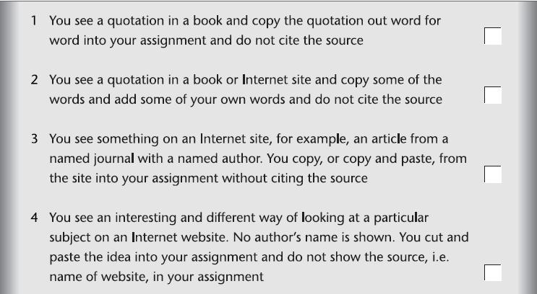

Slide 30
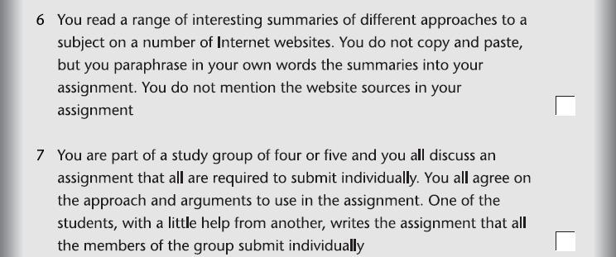
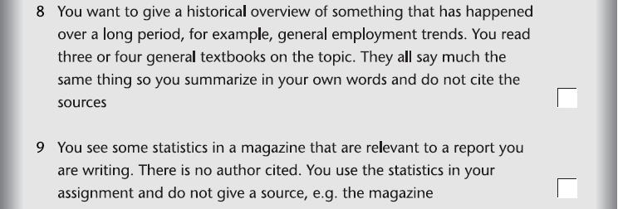

Slide 31
Thank You

